Slide 1
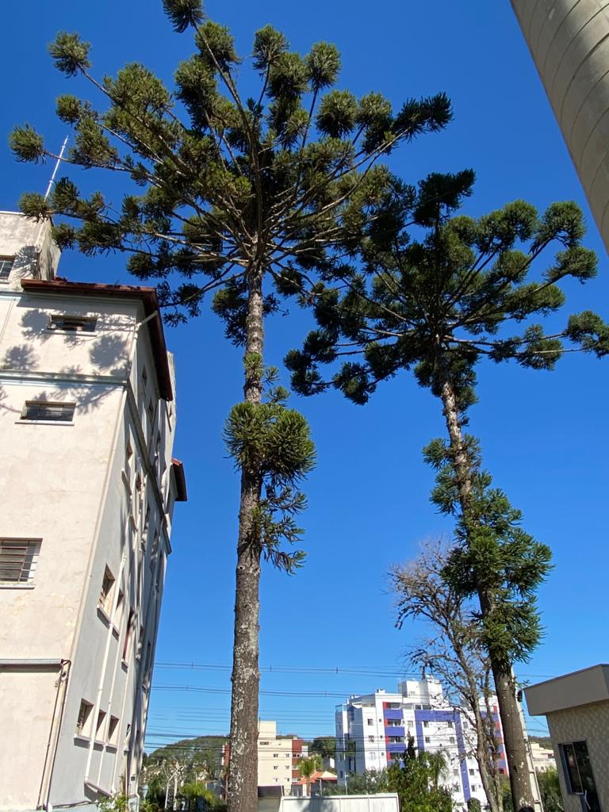
Curitiba, 18.06.2021

Slide 2
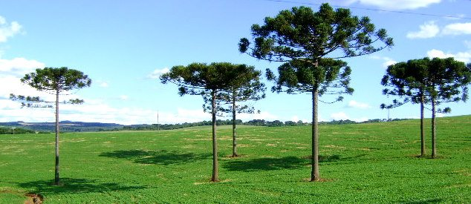
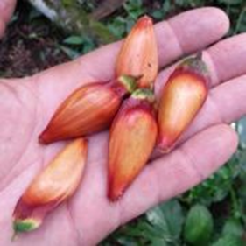
CURITIBA
= Tyba
Pine
Curii
=
A lot of

Slide 3
This is a pine tree in BEGINNING STAGE OF FORMATION...
The depth of its taproot is exactly the same as the visible part.
Its roots ARE IMMERSED IN THE DEPTH OF THE EARTH.
This feature allows you to
CONNECT WITH THE WORLD
through fruits that serve as food.
Note: Pine trees grow only in very specific terrain today ...

Slide 4
Roots don't build, roots dig While digging, the roots trace, ”in its own way", its own path. The path traced tirelessly seeks for water which will make it produce fruit for life. This water was not created by the root; it belongs to a deep fountain or to the rain that comes from heaven. The roots live in the shade of fruitful mystery!
The silent prophecy
of deeply
Embedded Roots

Slide 5
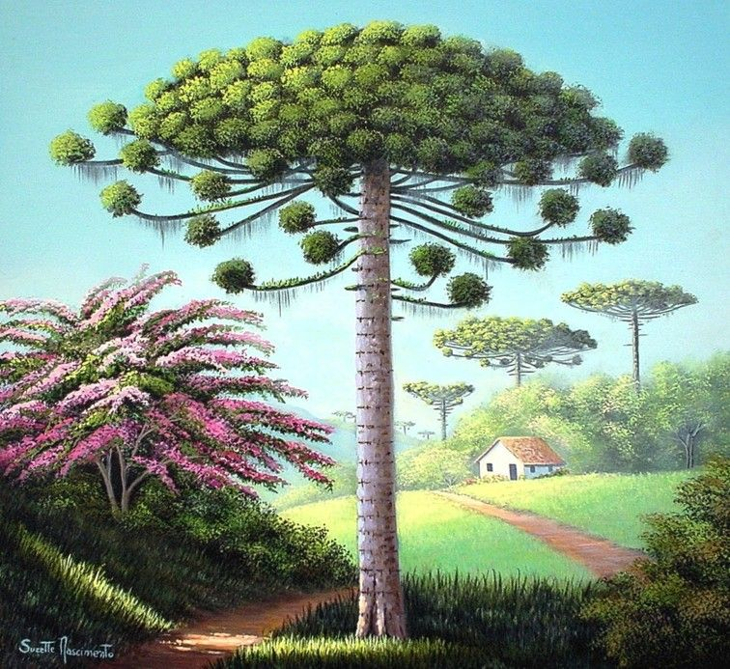
The trunk of the pine tree
The trunk has its origin exactly at the moment when the first root of the pine tree sprouts.
All roots seek to
remain attached to the trunk; if the root is cut or separated from the trunk, it either dies or gives rise to the “other” tree……
the solidity of the trunk
Connects
the roots and branches to each other.

Slide 6
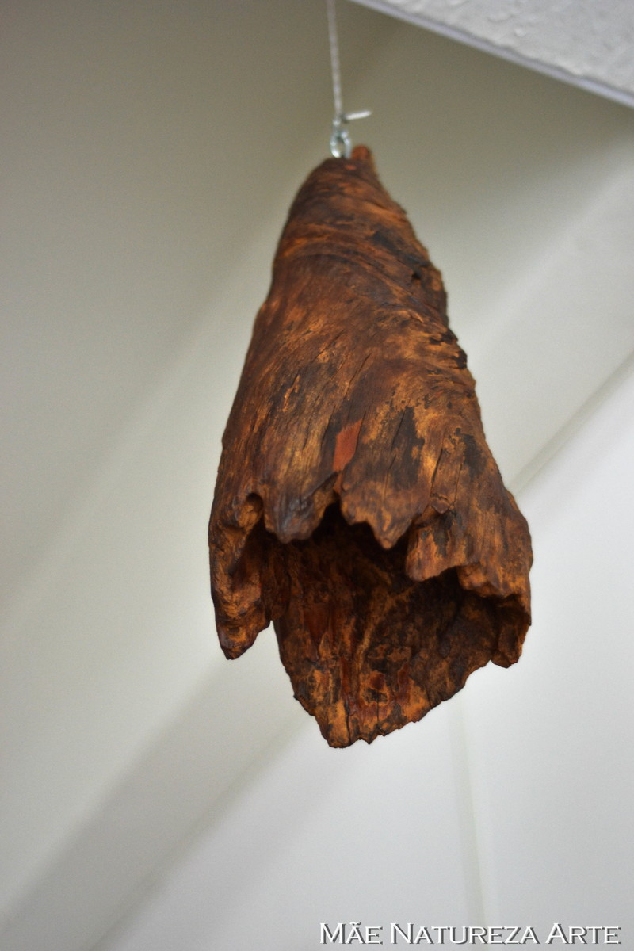
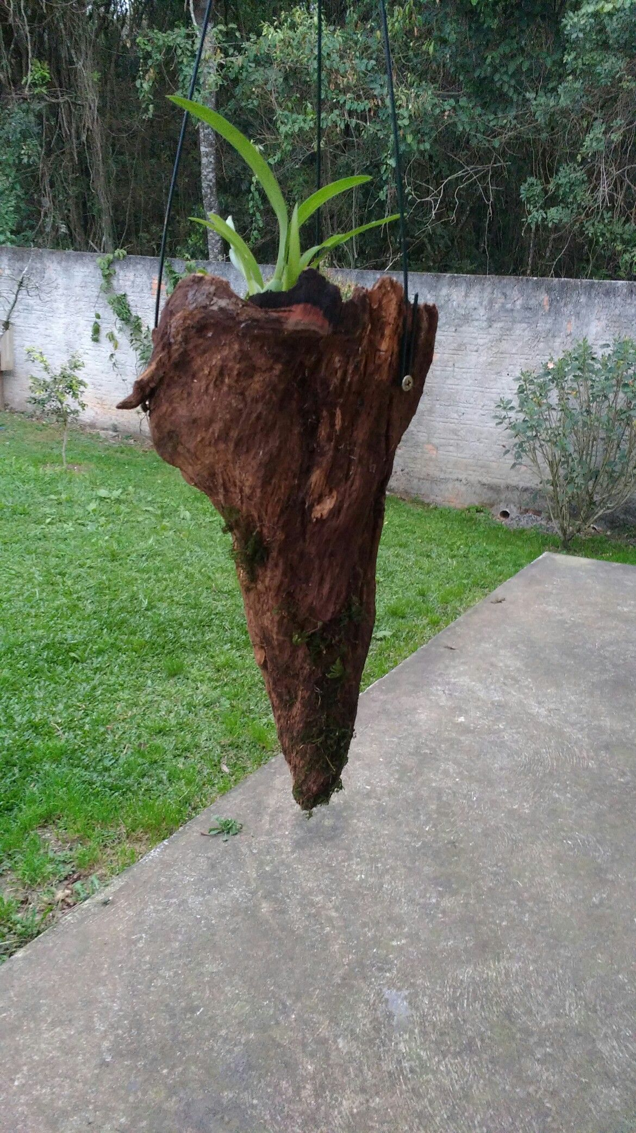
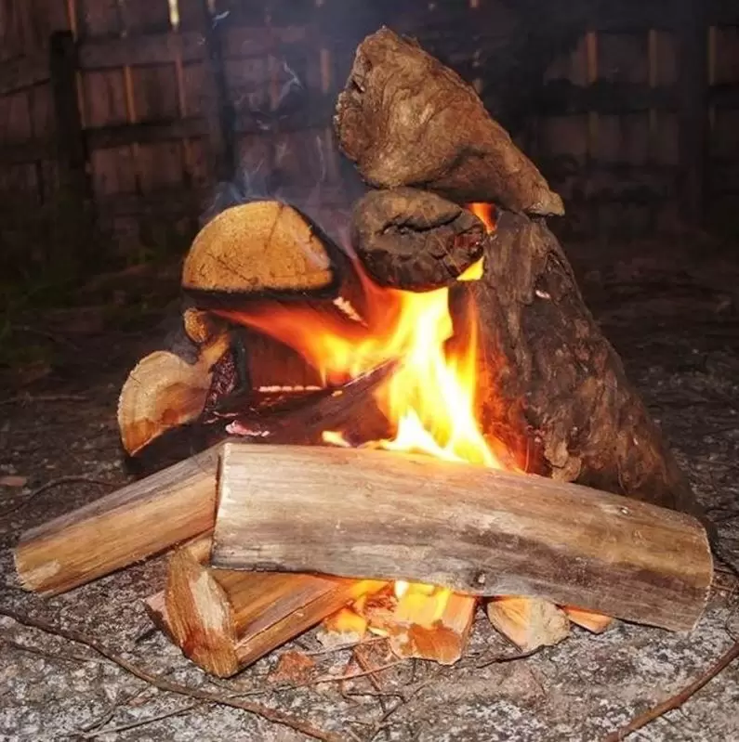
The pine knot “serves” :
To ensure the firmness of the "trunk”;
To warm up the homeless, the poor;
To beautify life for free...

Slide 7
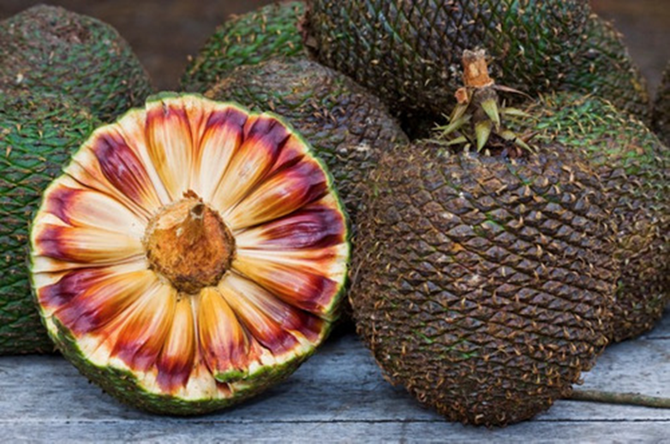
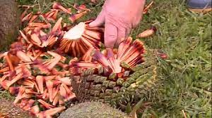
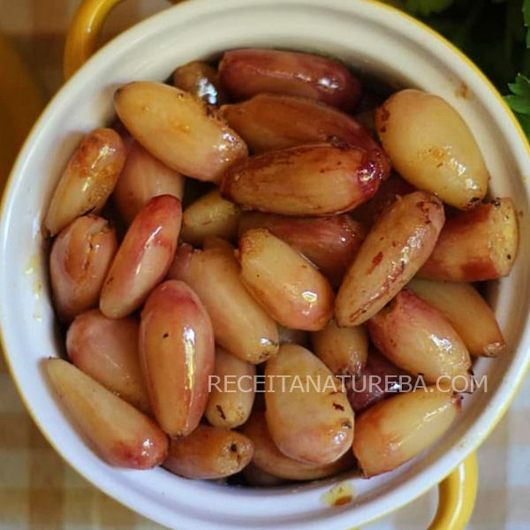
The fruit: PINE
The seed: PINE NUTS
(Community)
Connection with the world
The pine cone opens
When it is
“READY”
and spills its seeds

Slide 8
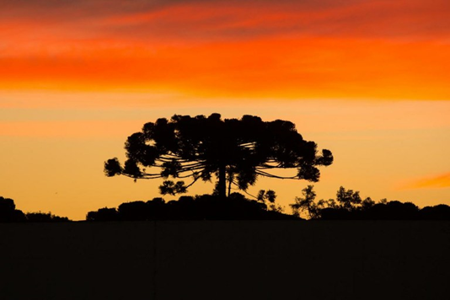
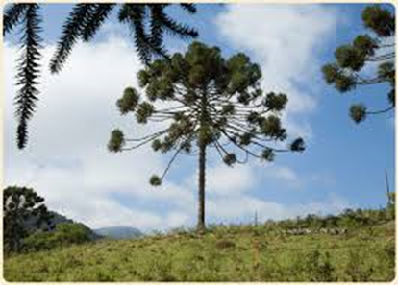
Stages of life visible in the pine canopy and...
3. open cup, generous!
2. cultivating circles
and... its process of formation.
1. Growing in stature.

Slide 9
“Now the whole group of those who believed were of one heart and soul, and no one claimed private ownership of any possessions, but everything they owned was held in common. ³³ With great power the apostles gave their testimony to the resurrection of the Lord Jesus, and great grace was upon them all.” Act 4:32-33

